Slide 1
Dark Vision
Jared Weissinger Matthew Rankin Liam Burns
Andrew Johnson

Slide 2
Dark Vision
Dark Vision is a guidance app for the Vision impaired. This app will help them through a building to their destination and give verbal warnings for turns, doors, if they are headed towards a wall, etc.
There seems to be a gap in the market for something like this as there wasn't anything that we could find on any appstore. This may be because it takes a lot of groundwork to set up as you need to map out the place that you are wanting to implement this at.

Slide 3
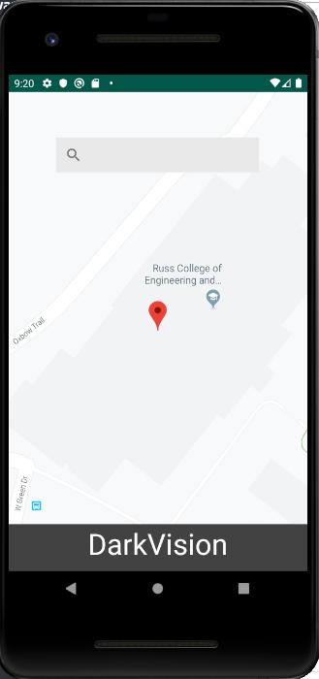
State of the App
So far on the main app we have positioning from google with the overlay in our map. That is all that we have gotten worked out since we changed the way that we were going to accomplish this late in the semester.

Slide 4
Branches from the project
As we were going to originally going to go down the route of doing all of the positioning ourselves and trying to figure that out there is a lot of the code done for that. Just was harder to actually implement than thought.
Had to abandon some features much later in development than we felt comfortable as we realized they would be infeasible to implement

Slide 5
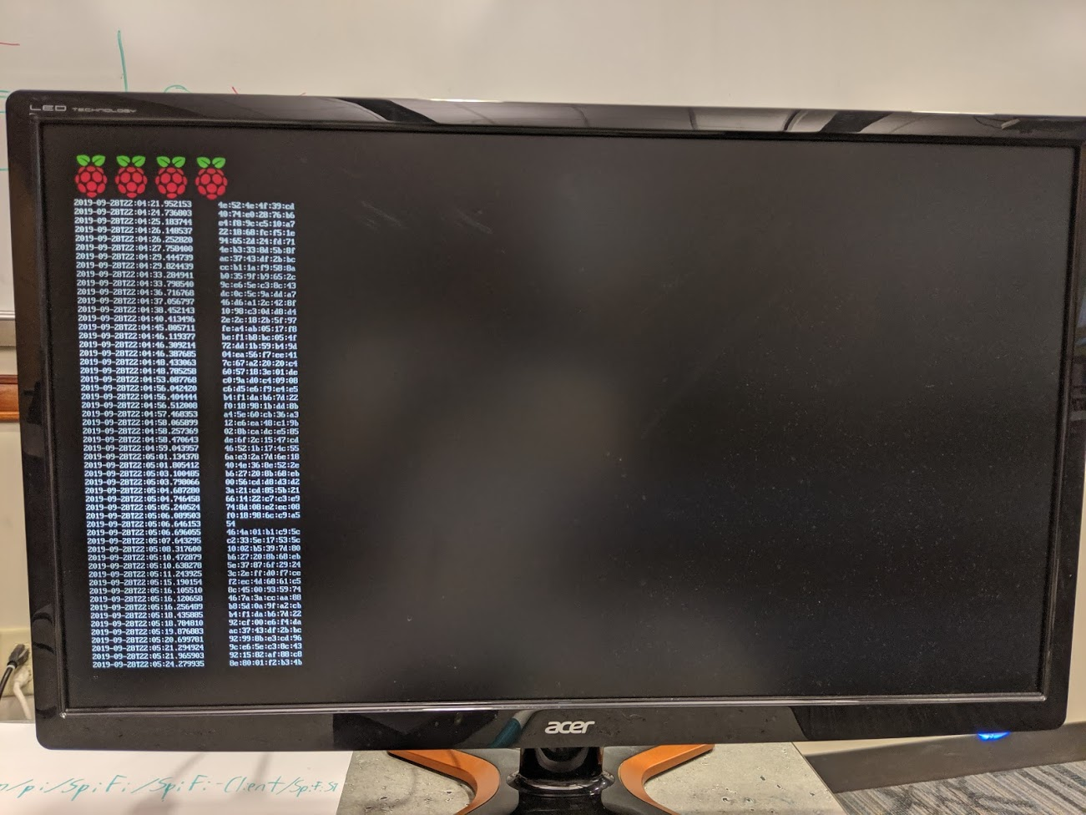
Examples from the original idea
This is from the original running on a Raspberry Pi. This is when we were going to try to do all of the indoor tracking ourselves and just pull it from the cloud.
We were going to use this to go from node to node. The accuracy on this would be very low as it was limited with the amount of nodes that we had. This caused this part to get scraped.

Slide 6
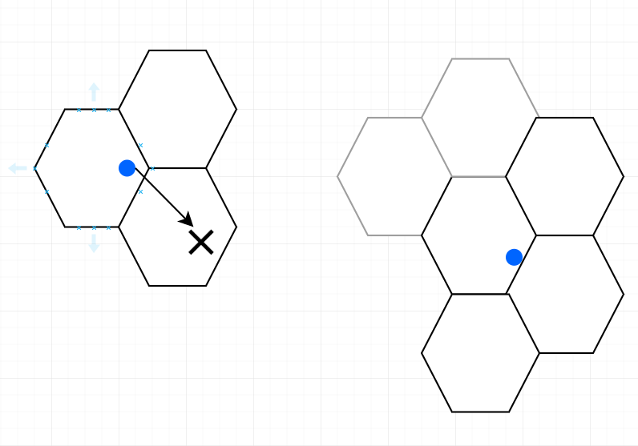
Trying to get more accurate
We went on from here trying to get a little more accuracy in the system. We were going to do this with a hexagon system that would anchor the person to 3 - 4 hexagons at a time and use those to hand off the positions. This would give us the accuracy that we were looking for as it was based off of 3 - 4 points in space.

Slide 7
Issues
We were working on this theory and trying to get it to work. The main issue that we were having with it was that the gyroscopic drift that we were dealing with from the phones was too much to overcome without some real magic.
We could mount this to the original system and try to base the hexagons off of the nodes and then go from there but then we are dealing with the original issue of trying to base everything off of a limited amount of nodes.

Slide 8
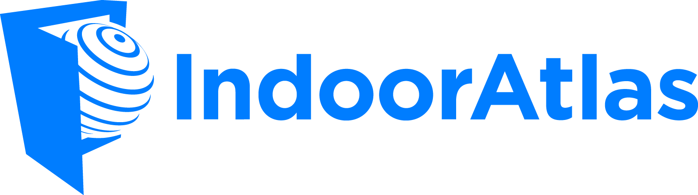
Moving to IndoorAtlas
We found out about IndoorAtlas after one of the groups presented and it was the underlying indoor position SDK that they used. If we weren’t stubborn in the early stages of the project by trying to do everything that we could by ourselves this app could have made the entire project work cleanly.
This had everything that we were looking for and it solved almost all of our issues that we were having. We just moved onto it way too late as we moved into this with less than a month to go for the deadline. This caused another rework for the team.

Slide 9
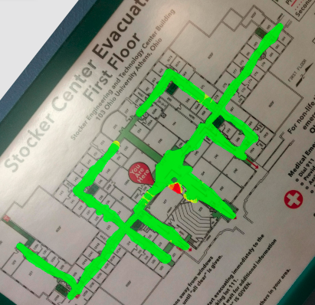
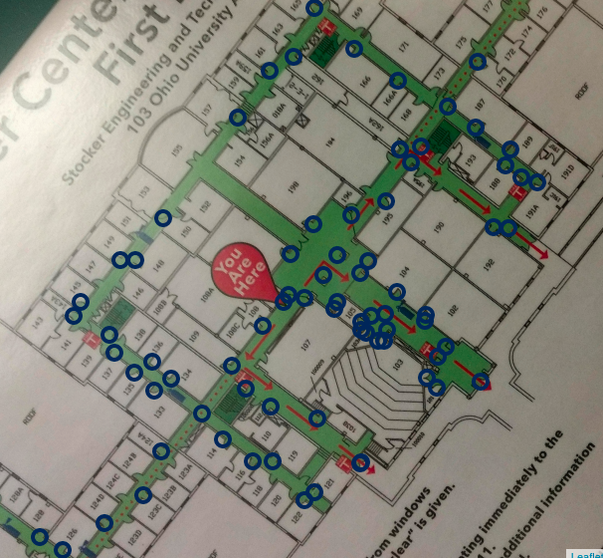
Mapping Examples
Here are the examples of the mapping that we did with the IndoorAtlas map.
We also tried to anchor every door# to a waypoint so that we would have more accurate wayfinding.

Slide 10
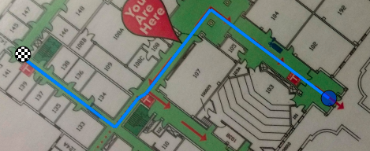
Wayfinding
This is an example of the wayfinding that we could achieve with the application.
This is as far as we got on the backend of this project

Slide 11
Individual Contributions
Jared: provided a base for the layout and structure of the app by designing what it would look like using Android Studio; had to learn Java for this
Liam: conducted early concept design for mapping, later abandoned for IndoorAtlas. Assisted with merging the IndoorAtlas SDK with Matt’s base code and helped with troubleshooting issues that arose therein.

Slide 12
Individual Contributions (cont.)
Andrew: Worked in Android Studio on getting the google api added to the project, set up the basic UI in the app. Also worked on some of the mapping with indoor atlas.
Matt: At first I started with the node based system, then moved onto the Hexagon anchoring system. Worked on setting up the IndoorAtlas mapping, then getting it to do everything that we wanted. Tried to learn Java way too late in the cycle which hindered our ability to get the second app out.

Slide 13
Final Notes
We had issues merging all of the IndoorAtlas stuff with the app that we had made originally. This is what we have been fighting the last couple weeks, as we decided that we should just start new and try to get it to work that way. With the holidays, we never achieved the second app.

Slide 14
Learning Java and Android Studio
Not too difficult, especially through Android Studio. However, knowledge of what can and cannot be done within the language hurt us later in the dev cycle.
Another thing that burned us in this respect is that some of us were trying to learn Java too late in the cycle.
There were many issues with Android Studio in the group. People had some trouble getting it to install, running, and building the project. This was also the first time that some of us had ever used api’s and keys.
It was a valuable experience to learn to adjust and fix the technical issues with android studio and it was also good to learn how to tie two different companies code together.

